Slide 1
Virtual Networking

Slide 2
Azure Networking Components
Virtual Network
Subnets
NICs
NSGs
Load Balancer
Public IP
Traffic Manager

Slide 3
Virtual Network
It is a representation of your own network in the cloud.
It is a logical isolation of the Azure cloud dedicated to your subscription.
Each VNet has its own CIDR block.

Slide 4
Virtual Network
CIDR – Classless Interdomain Routing
10.0.0.0/16 – Address Space - 65536 IP Addresses
32 – 16 = 16
2 to the power 16 = 65536
10.0.0.0/24 – 256

Slide 5
Private IP
10.0.0.0 – 10.255.255.255
172.16.0.0 - 172.31.255.255
192.168.0.0 - 192.168.255.255

Slide 6


















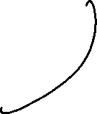









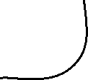





Slide 7


















Slide 8
Subnets
Virtual network can be segmented into one or more subnets.
Subnets provide logical division within your networks

Slide 9
Subnets
Service Requirement
Service Endpoints
Network Security Group – Zero or one network security group to each subnet

Slide 10
IP Addressing and Endpoints

Slide 11
IP Addressing
Communicate with other Azure resources, your on-premises network and internet.
Private IP – Communication within VNets
Public IP – Communication with internet or Azure Public facing services

Slide 12
Public IP Address
Public IP Address | IP Address Association
Virtual Machine | NIC
Load Balancer | Front-end configuration
VPN Gateway | Gateway IP configuration
Application Gateway | Front-end configuration
SKU:
Basic
Standard

Slide 13











Private IP Address
Public IP Address | IP Address Association
Virtual Machine | NIC
Internal Load Balancer | Front-end configuration
Application Gateway | Front-end configuration
10.0.0.0/16
Allocated – 10.0.0.4 – 10.0.0.9
Dynamic – 10.0.0.10
Static – 10.0.0.10 – 10.0.255.254

Slide 14
Service Endpoint
It provides the identity of your virtual network to the Azure service.
Azure Service
Storage Account
Internet
Virtual Machine
Private IP: 10.0.0.4
Service Endpoint
<Subnet>
<Vnet>

Slide 15

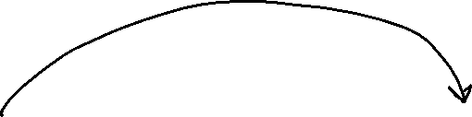


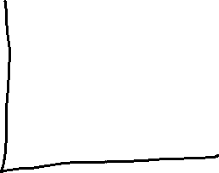


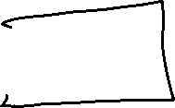
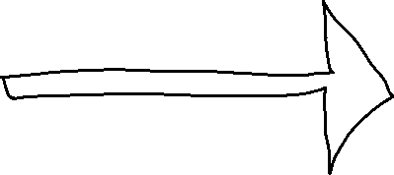


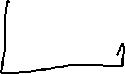











Slide 17
Service Endpoint
Improved security for your Azure service resources
Optimal routing for Azure service traffic from your virtual network
Endpoints always take service traffic directly from Microsoft Backbone Network
Simple to setup with less management overhead

Slide 18
Service Endpoint
https://learn.microsoft.com/en-us/azure/virtual-network/virtual-network-service-endpoints-overview

Slide 19
Network Security Group

Slide 20
Network Security Group
Limit the network traffic to resources in a virtual network.
NSG contains a set of rules that allow or deny inbound or outbound network traffic.
NSG can be attached to:
NIC
Subnet

Slide 21
NSG Rules
Default Inbound Rules – Deny all inbound traffic except from the virtual network and Azure load balancers
Default Outbound Rules – Only allow outbound traffic to the internet and the virtual network
The default rules cannot be deleted

Slide 22

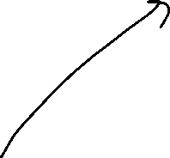










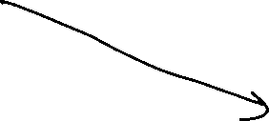




Slide 23
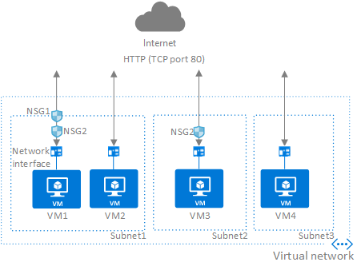


Slide 24
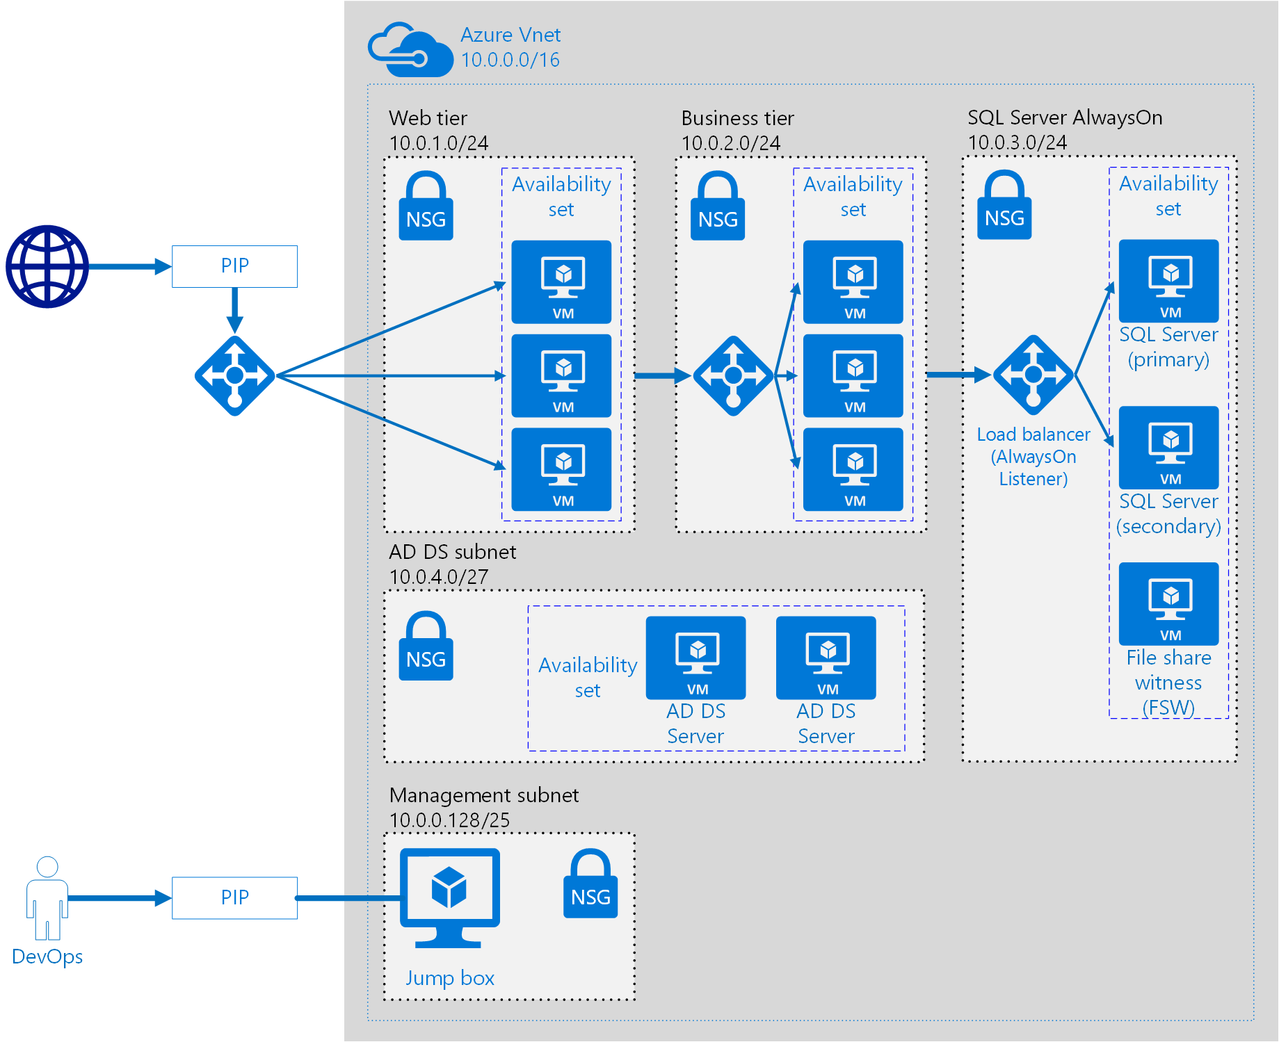
You are working as a Senior Cloud Architect in an organization. You have been asked to deploy three tier application.
Which of the below would you use to ensure minimum management overhead.
A. 1 Vnet 1 Subnet
B. 1 Vnet 3 Subnet
C. 3 Vnet 3 subnet
D. 3 Vnet 1 subnet

